Slide 1

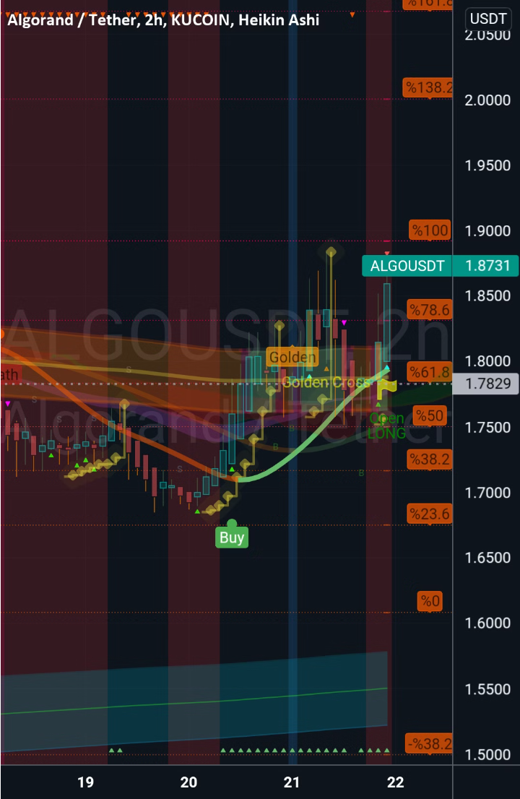
Algorithmic Trading Intro and Strategies
Understand quantitative finance and trading to automate your trading strategy. Learn how to create your trading strategy building process.

Slide 2

Name | Roll Number
Prajwal Waykos | 471081
Neemeesh Khanzode
Jyotirmay Khavasi

Slide 3
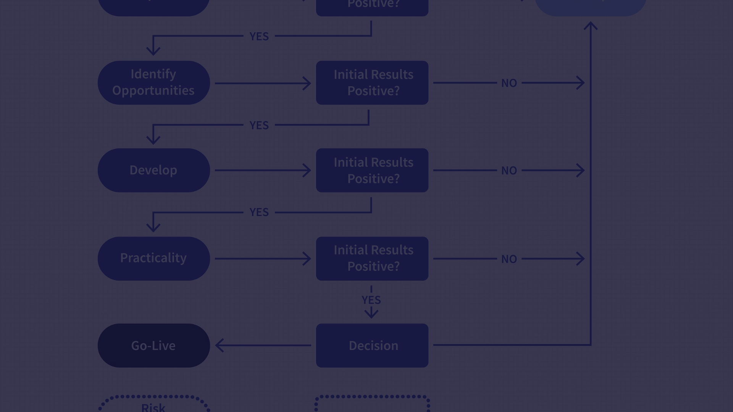
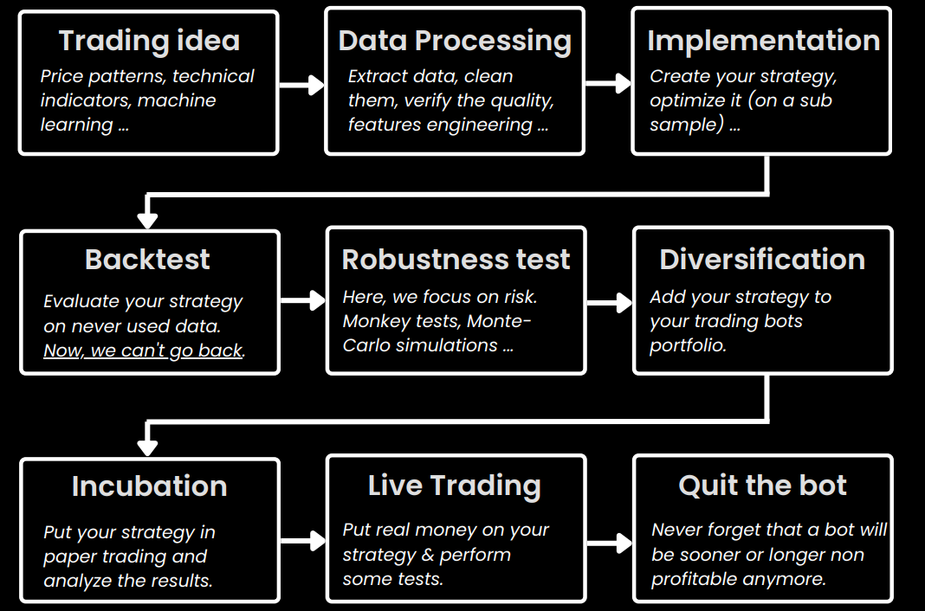
Trading Strategy Building Process

Slide 4
Simple vs Compounded Interest
Simple Interest
Compounded Interest
Compounded Interest Drawbacks
With simple interest you compute the interest on the INITIAL capital, without considering the previous interest.
With compounded interest you will use the CURRENT capital.
Compounded interests aren't optimal when you have big losses. It's better to use simple interest (fixed volume) for risky trading strategies.
In trading, the volume reflects the capitalization method: dynamic volume.
In trading, the volume reflects the capitalization method: fixed volume.

Slide 5
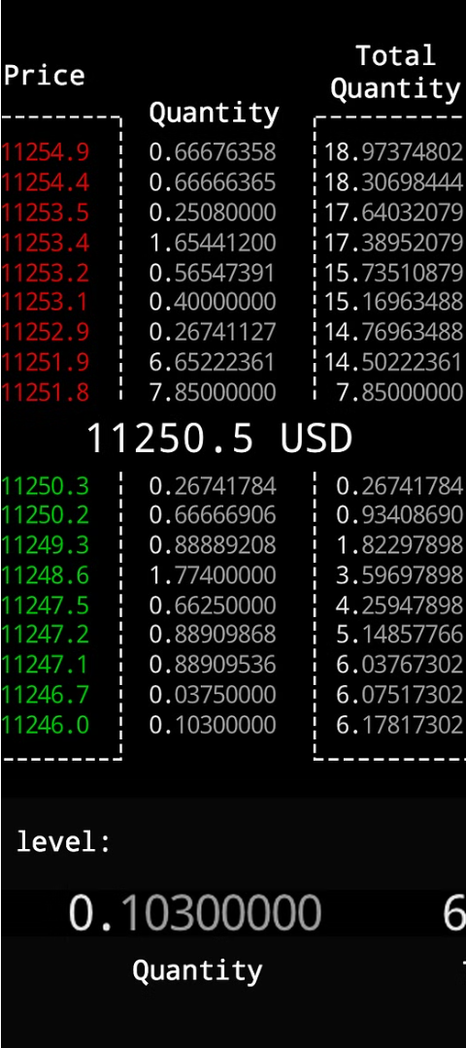
Market Microstructure Basis
1
Order Types
2
Order Book
Market orders and pending orders (buy stop, buy limit, sell stop, sell limit)
All trading orders are saved in the order book
3
Trading Terminology
Spread, commission, slippage

Slide 6
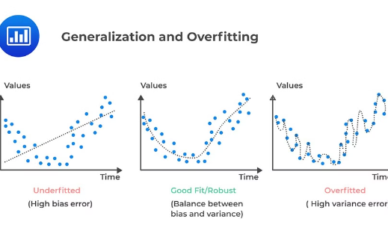
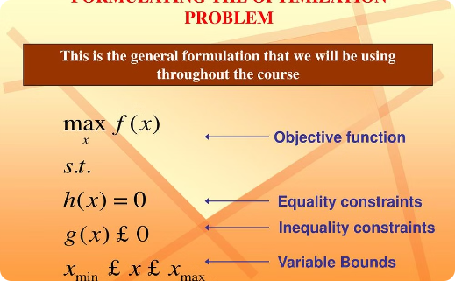

Overfitting & Overoptimizing
Overfitting
Overoptimizing
Look-Ahead Bias
A model that is too tightly fitted to the training data, resulting in poor performance on new data.
Over-adjusting a trading strategy to match historical data, without considering market changes.
Analyzing the whole backtest period to choose optimal parameters, instead of using an independent test set.

Slide 7
Backtesting Metrics
AUM (Assets Under Management)
Profit & Loss (P&L)
The value of the assets under management, used to find the right position sizing.
The total dollars generated over the backtest period.
Drawdown
Risk Reward Ratio
The maximum loss from the last highest point, a measure of risk.
The average earnings of winning trades over the average loss of losing trades.

Slide 8
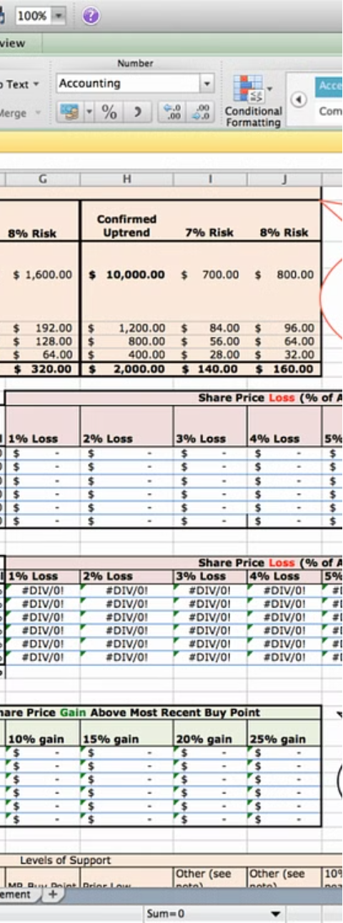


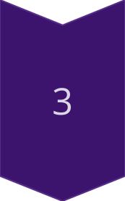
In-Sample vs Out-Sample Optimization
Train Set
Use to optimize strategy parameters
Test Set
Use to evaluate strategy on unknown data
No Going Back
Cannot re-optimize on the test set to avoid over-optimizing

Slide 9
Walk Forward Optimization
Anchored
1
Train on earlier data, test on later data. Repeat with sliding window.
2
Unanchored
Train and test on different, non-overlapping periods. Repeat with sliding window.
Advantages
3
Reduces overfitting, accounts for changing market conditions.

Slide 10
Thank you

